Slide 1

Data Analytics
Assignment -1
Presented By:- Sneha Kumari
Notes:
Prep. By:- Sneha Kumari

Slide 2

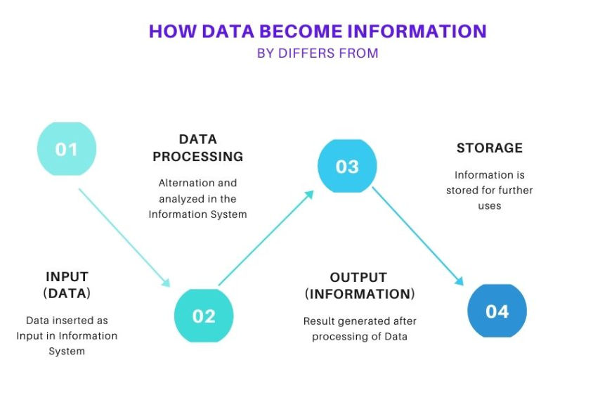
Different Between Data and Information.
Data
Data is unorganized and unrefined facts.
Data is an individual unit that contains raw materials which do not carry any specific meaning.
Data doesn’t depend on information.
Raw Data alone insufficient for decision making.
An example of data is a student’s test score.
Information
Information comprises processed, organized data presented in a meaningful context.
Information is a group of data that collectively carries a logical meaning.
Information depends on Data.
Information is sufficient for decision making.
The average score of a class is the information derived from the given data.

Slide 3

How Data is useful
Data helps understand and improve business processes so you can reduce
Money and time.Every company feels the effects of waste .It depletes resources,squanders time,and ultimately impacts the bottom line.
Without data ,how do you know who your customers are ? How do you know
If consumers like your products or if your marketing efforts are effective?
Without data ,how do you know how much money you are making or spending?
Data is key to understanding your customers and market.

Slide 4
What is Big Data.
Big data is a collection of data that is huge in volume ,yet growing exponentially with time.It is a data with so large size and complexity that none of traditional data management tools can store it or process it efficiently.
Volume ,variety ,velocity ,and variability are few big data characteristics.
Benefits and Advantages of Big Data Analytics.
Businesses can utilize outside intelligence while .taking decisions.
Improved customer service.
Better operational efficiency.

Slide 5
Different between structured, semi-structured, unstructured data
Structured Data:- This type of data consists of various addressable elements to encourage effective analysis. The structured form of data gets organized into a repository (formatted) that acts as a typical database. Structured data works with all kinds of data that one can store in the SQL database in a table that consists of columns and rows. These consist of relational keys, and one can easily map them into pre-designed fields. People mostly use and process structured data for managing data in the simplest form during the development process. Relational data is one of the most commendable examples of Structured Data.
Semi- Structured Data:- It is the type of information and data that does not get stored in a relational type of database but has organizational properties that facilitate an easier analysis. In other words, it is not as organized as the structured data but still has a better organization than the unstructured data. One can use some processes for storing this type of data and info in the relational database, and this process can be pretty difficult for some semi-structured data. But overall, they ease the space available for the contained information. XML data is an example of semi-structured data.
Unstructured Data:- It is a type of data structure that does not exist in a predefined organized manner. In other words, it does not consist of any predefined data model. As a result, the unstructured data is not at all fit for the relational database used mainstream. Thus, we have alternate platforms to store and manage unstructured data. It is pretty common in IT systems. Various organizations use unstructured data for various business intelligence apps and analytics. A few examples of the unstructured data structure are Text, PDF, Media logs, Word, etc.

Slide 6
.Different between structured, semi-structured, unstructured data
Structured data
The information and data have a predefined organization.
Unstructured data
There is no predefined organization for the available data and information in the system or database.
Semi –structured data
Semi-structured data is mixture of structured and unstructured data.
Structured data is robust in nature.
The data depends a lot on the schema.Thus there is less flexibility.
It is an usually text format .
It has limited storage options.
Ex-OLAPS ,SQLite , MySQL, PostgreSQL .
Unstructured data is available in all format.
It has unlimited storage options.
Ex- emails, videos , photos ,audio files ,social media etc.
Semi structured data does not follow the format of a tabular data model or relational databases.
It is more flexible and simpler to scale compared to structured data.
Ex-HTML code,CSVfiles,JSON files.

Slide 7
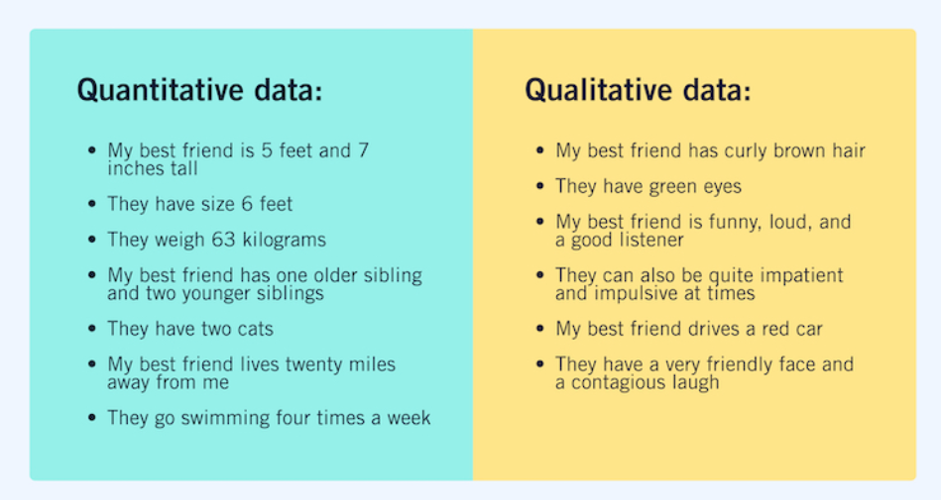
What is Quantitative data and Qualitative data
Quantitative data
Quantitative data refers to any information that can be quantified. If it can be counted or measured, and given a numerical value, it’s quantitative data. Quantitative data can tell you “how many,” “how much,” or “how often”—for example, how many people attended last week’s webinar? How much revenue did the company make in 2019? How often does a certain customer group use online banking?
To analyze and make sense of quantitative data, you’ll conduct statistical analyses.
Qualitative data
Unlike quantitative data, qualitative data cannot be measured or counted. It’s descriptive, expressed in terms of language rather than numerical values.
Researchers will often turn to qualitative data to answer “Why?” or “How?” questions. For example, if your quantitative data tells you that a certain website visitor abandoned their shopping cart three times in one week, you’d probably want to investigate why—and this might involve collecting some form of qualitative data from the user. Perhaps you want to know how a user feels about a particular product; again, qualitative data can provide such insights. In this case, you’re not just looking at numbers; you’re asking the user to tell you, using language, why they did something or how they feel.
Qualitative data also refers to the words or labels used to describe certain characteristics or traits—for example, describing the sky as blue or labeling a particular ice cream flavor as vanilla.
Notes:
Prepared By:-Sneha Kumari

Slide 8
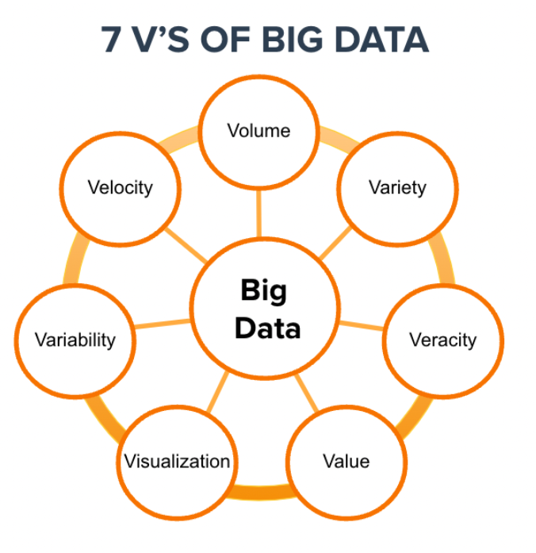
Different V’s in Big Data
Defining big data allows you to derive more value from partnership marketing and the seven Vs sum it up pretty well:
As more brands turn to partnership marketing as a revenue-generating channel, understanding the 7 Vs of big data results in a winning partnership program and, ultimately, business growth.
1. Volume
Volume defines how much data we have – what we used to measure in Gigabytes is now measured in Zettabytes (ZB) or even Yottabytes (YB). The Internet of Things (IoT) creates exponential growth in data. Projections show the volume of data changing significantly in the coming years.
2. Velocity
Velocity represents the speed at which data is processed and becomes accessible. Today, if delivery is not real-time, it’s usually not fast enough.
3. Variety
Variety describes one of the biggest challenges of big data. The insights may come without structure. The total asset may include many data types, from XML to video to SMS. Organizing the data in a meaningful way is no simple task when the data itself changes rapidly.
4. Variability
Variability is different from variety. A coffee shop may offer six different blends of coffee, but if you get the same blend every day and it tastes different every day, that is variability. The same is true of data. If the meaning constantly changes, it can significantly impact your data homogenization.
5. Veracity
Veracity ensures the data is accurate, which requires processes to keep the insufficient data from accumulating in your systems. The simplest example is when contacts enter your marketing automation system with false names and inaccurate contact information. How many times have you seen Mickey Mouse in your database? It’s the classic “garbage in, garbage out” challenge.
6. Visualization
Visualization is critical in today’s world. Using charts and graphs to visualize large amounts of complex data is much more effective in conveying meaning than spreadsheets and reports chock-full of numbers and formulas.
7. Value

Slide 9
Name of popular Tools used in Big Data
There are hundreds of data analytics tools out there in the market today but the selection of the right tool will depend upon your business NEED, GOALS, and VARIETY to get business in the right direction. Now, let’s check out the top 10 analytics tools in big data.
1. APACHE Hadoop.
2. Cassandra
3. Qubole
4. XPlenty
5. Spark
6. Mongo DB
7. Apache Storm
8. SAS
9. Data Pine
10. Rapid Miner
Conclusion
Big data has been in limelight for the past few years and will continue to dominate the market in almost every sector for every market size. The demand for big data is booming at an enormous rate and ample tools are available in the market today, all you need is the right approach and choose the best data analytic tool as per the project’s requirement.

Slide 10
What are the different type of Data
4 Types of Data: Nominal, Ordinal, Discrete, Continuous
Qualitative Data Type
Nominal
Ordinal
Quantitative Data Type
Discrete
Continuous
Data is all about experimenting with raw or structured data. Data is the fuel that can drive a business to the right path or at least provide actionable insights that can help strategize current campaigns, easily organize the launch of new products, or try out different experiments.
Qualitative Data Type:-
Nominal:-These are the set of values that don’t possess a natural ordering. Let’s understand this with some examples. The color of a smartphone can be considered as a nominal data type as we can’t compare one color with others.
It is not possible to state that ‘Red’ is greater than ‘Blue’. The gender of a person is another one where we can’t differentiate between male, female, or others. Mobile phone categories whether it is midrange, budget segment, or premium smartphone is also nominal data type.
Nominal data types in statistics are not quantifiable and cannot be measured through numerical units. Nominal types of statistical data are valuable while conducting qualitative research as it extends freedom of opinion to subjects.
Ordinal
These types of values have a natural ordering while maintaining their class of values. If we consider the size of a clothing brand then we can easily sort them according to their name tag in the order of small < medium < large. The grading system while marking candidates in a test can also be considered as an ordinal data type where A+ is definitely better than B grade.
These categories help us deciding which encoding strategy can be applied to which type of data. Data encoding for Qualitative data is important because machine learning models can’t handle these values directly and needed to be converted to numerical types as the models are mathematical in nature.
For nominal data type where there is no comparison among the categories, one-hot encoding can be applied which is similar to binary coding considering there are in less number and for the ordinal data type, label encoding can be applied which is a form of integer encoding.

Slide 11

Quantitative Data Type
This data type tries to quantify things and it does by considering numerical values that make it countable in nature. The price of a smartphone, discount offered, number of ratings on a product, the frequency of processor of a smartphone, or ram of that particular phone, all these things fall under the category of Quantitative data types.
The key thing is that there can be an infinite number of values a feature can take. For instance, the price of a smartphone can vary from x amount to any value and it can be further broken down based on fractional values. The two subcategories which describe them clearly are:
Discrete
The numerical values which fall under are integers or whole numbers are placed under this category. The number of speakers in the phone, cameras, cores in the processor, the number of sims supported all these are some of the examples of the discrete data type.
Discrete data types in statistics cannot be measured – it can only be counted as the objects included in discrete data have a fixed value. The value can be represented in decimal, but it has to be whole. Discrete data is often identified through charts, including bar charts, pie charts, and tally charts.
Continuous
The fractional numbers are considered as continuous values. These can take the form of the operating frequency of the processors, the android version of the phone, wifi frequency, temperature of the cores, and so on.
Unlike discrete data types of data in research, with a whole and fixed value, continuous data can break down into smaller pieces and can take any value. For example, volatile values such as temperature and the weight of a human can be included in the continuous value. Continuous types of statistical data are represented using a graph that easily reflects value fluctuation by the highs and lows of the line through a certain period of time.

